Slide 1
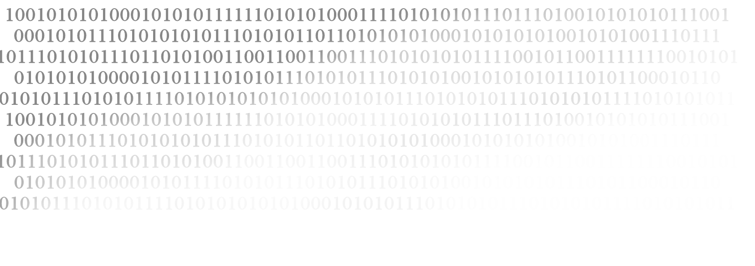









FREE!
Computer Enhancement Workshop
Learn to change your computer’s memory !
You choose! Watch and learn OR hands on!
Join us and learn some basic computer skills.
-Clean your computer case
-Update Drivers
-Install new hard drives
-Install new sound cards
-Install more memory
-Clean and defrag
- Change your power supply
-Partition your drive
Thursday, October 30th
5:30 to 7:00pm
Trueblood Hall
Lower Level Study Lounge
And other
Useful
Tips!

